Slide 1
Innovative high performance Alloys and Coatings for HIghly EFficient intensive energy processes
EU H2020 project: ‘ACHIEF’-General presentation
1

Slide 2
Project overview
Grant agreement no.: 958374
Coordinator: COMMISSARIAT A L’ENERGIE ATOMIQUE ET AUX ENERGIES ALTERNATIVES (CEA), france
Participants: 11 partners from 6 EU countries (Belgium, Finland, France, Germany, Italy, Spain) & Turkey
Duration: 1 October 2020-31 March 2024 (42M)
Project budget: 5.8 MEUR
2

Slide 3











Partners
3

Slide 4
The importance & challenges of Energy Intensive Industries (EIIs)
Positive
20% of EU GDP
6,3 million jobs
Negative
15% of total EU CO2 emissions
40% of global CO2 emissions
1/3 of global energy demand
Source: T. Wyns, G. Khandekar, I. Robson (2018), Industrial Value Chain: a bridge towards a carbon neutral Europe, Report of IES-VUB & EEA (2019) Annual European Union greenhouse gas inventory 1990–2017 and inventory report 2019. Brussels: European Environment Agency.
4
Notes:
EII are a major part of the EU economy-generating 20% of the GDP and 6.3 million direct jobs (Wyns et.al, 2018)
1/3 of global energy demand and 40% of CO2 emissions come from EII (Wyns et.al, 2018)
15% of total EU emissions come from EII (Wyns et.al, 2018)
EEI have to contribute to the European Action Plan on energy efficiency by saving 20% of primary energy

Slide 5
The ACHIEF concept
Goal: Improving process performance and energy efficiency in EIIs by developing more durable materials components and equipment
How will ACHIEF work?
Implementing novel Integrated Artificial Intelligence-aided Materials Toolbox (IAIMT)
Developing novel efficient materials & coating solutions
Validating the developed materials & coating solutions in three end user’s cases: aluminum, steel, petrochemicals
Promoting and disseminating the results of the project
5

Slide 6
The ACHIEF objectives
Developing models for materials design based on computational modelling & AI (WP2)
Developing novel protective Polymer Derived Ceramic (PDC) coatings with improved high-temperature erosion and corrosion resistance (WP3)
Developing innovative high-temperature strength and creep resistance materials based on novel High-Entropy Alloys (HEAs) to allow reaching higher process temperatures (WP4)
Designing a new high Chromium steel grade with creep resistance 15% improved (WP5)
Developing temperature and strain Fiber Bragg Grating sensors to be embedded in components fabricated with HEA materials or coated with PDC coatings (WP6)
Demonstrating the performance and efficiency of the developed materials and coating solutions in three use cases: PDC coatings & HESA nano-composite coatings in aluminium use case, HESA materials in steel use case, PDC coatings in petrochemical use case (WP7)
Promoting and disseminating the results of the project (WP8&9)
6

Slide 7
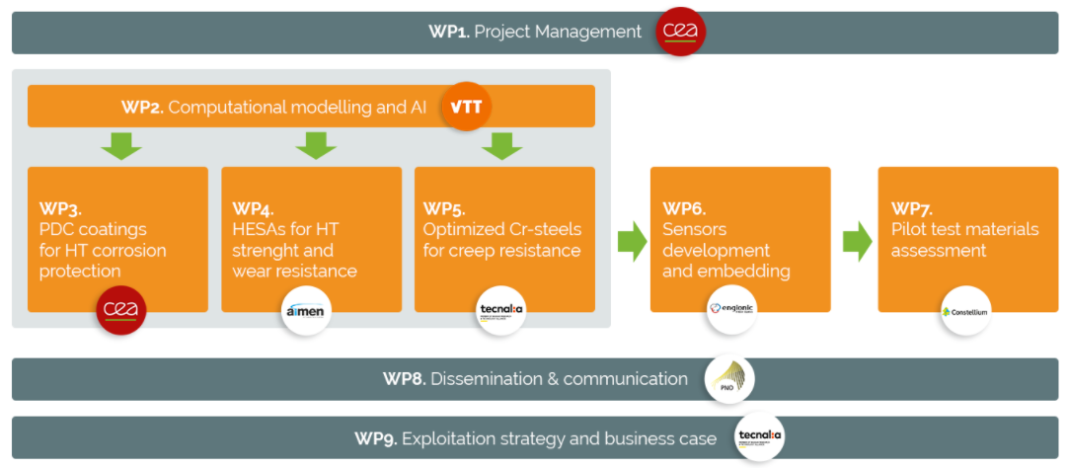
ACHIEF Workplan
7

Slide 8










ACHIEF value chain
Digital tools& analysis
Material
Component
Process
Application
HEA Coatings and bulk
Lased DED LBM
Powder supply
Instrumented industrial pilots
1
AI & Modeling
New PDC composition design to validation
Coating application on parts
Coated parts
Instrumented industrial pilots
2
Steel grades
Steel grades casting
Integrated process
Instrumented industrial pilots
3
8

Slide 9
From TRL 3 to TRL5
TRL 3/4
ACHIEF addresses different technological and materials solutions, starting from TRLs 3-4, with the goal of taking them to an overall final TRL5.
These solutions will be further studied and developed through extensive laboratory tests for screening of advanced high-performance materials (TRL3). Subsequently, the concept will be validated at laboratory level (TRL4), followed by its demonstration at relevant environments in three end user’s cases (TRL 5): CONSTELLIUM (France), ARCELOR MITTAL SESTAO (Spain), TUPRAS (Turkey).
TRL 3 – Experimental proof of concept
TRL4 – Technology validated in lab
TRL 5
TRL 5 – Technology validated in relevant environment
9

Slide 10



Expected impacts
Improving energy efficiency by 30%
-
-
Reducing CO2 emissions by 20 %
Increasing equipment lifetime >20%
10

Slide 11
References
EEA. (2019). Annual European Union greenhouse gas inventory 1990–2017 and inventory report 2019. Brussels: European Environment Agency.
T. Wyns, G. Khandekar, I. Robson. (2018). Industrial Value Chain: a bridge towards a carbon neutral Europe, Report of IES-VUB
11

Slide 12




Thank you. Get in touch for more information!
Project coordinator: Marie Cabaret-Lampin
Contact us: info@achief.eu
Vist our website: https://www.achief.eu/
Follow us on Twitter!
@ACHIEF42681668
Follow us on LinkedIn!
ACHIEF H2020
12

